Slide 1
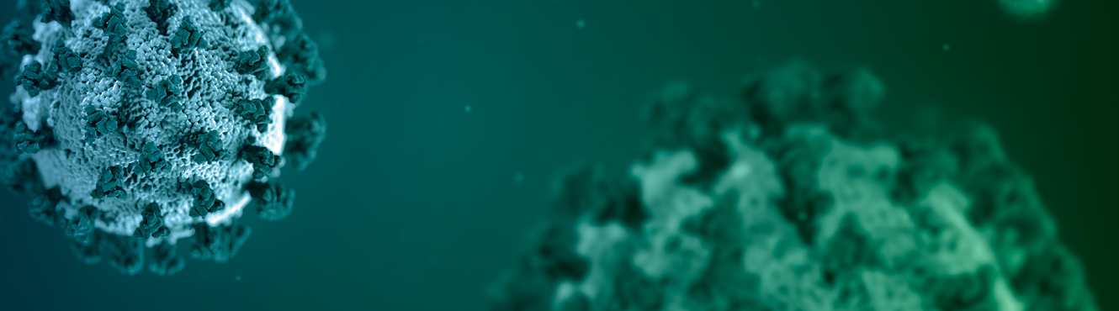
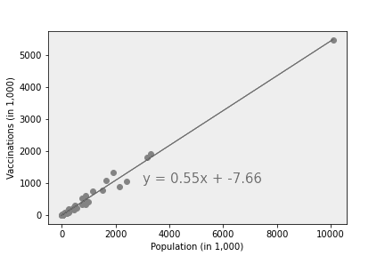
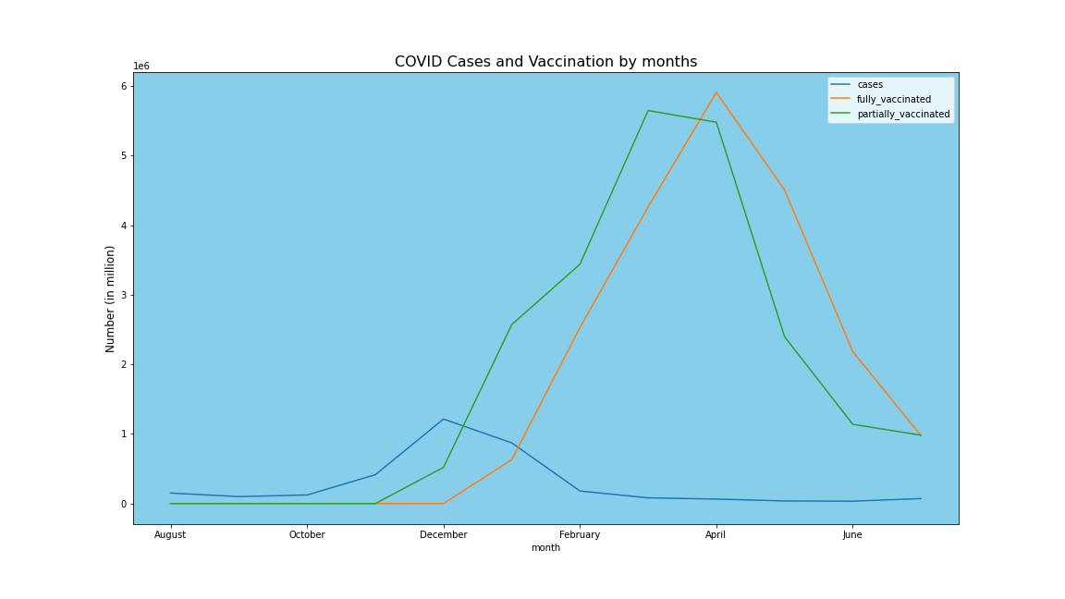
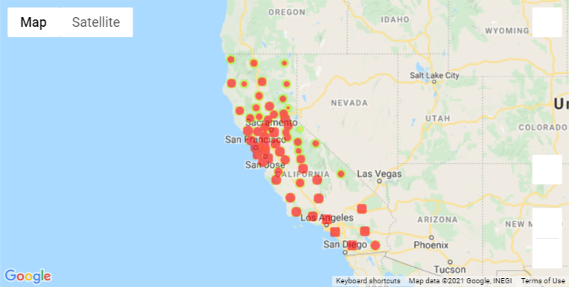

COVID-19 Vaccination California
Team members:
- Tikaram Subedy
- Kristian Hamilton
- David Koski

Slide 2
Project analysis slide 2
Project Outline
Reporting and Presentation
Data collection and Source
Analysis of COVID 19 Vaccination
California
Analyzing Statistically
Data Cleaning using Pandas Jupyter Notebook
Generating plots and charts
Data Slicing, merging and aggregating

Slide 3
Project analysis slide 3
Project Plan
California Data
Data Cleaning and Preparation
ANALYSIS
Trends and Charts
Report and Presentation
Performed Analysis on
Overall California, and Counties in Cases, Demographics, and Vaccinations
Cases, Vaccination and Demographic data
Data Cleaning and Preparation using Python and Pandas in Jupyter Notebook
Cases and Vaccination trends were analyzed.
Fitted regression models (linear)
Prepared data analysis report. Recommendations and further ……

Slide 4
Summarize where and how we found the data used to answer these questions
Importing COVID19 data and preparing it for the analysis by slicing and aggregating.
Deciding on and calculating a good measure for analysis.
Merging datasets and finding correlations among the dataset.
Visualizing the analysis results using Pandas and Matplotlib.

Slide 5
What Affects Vaccination in CA?
How is the vaccination trend in overall CA as well counties?
Is there a relationship between cases and deaths that has affected in vaccination?
Do demographics affect on vaccination?
Does location and time affect vaccination?

Slide 6

Project analysis slide 5
Analysis
After the vaccination started in December and made available to wider range of population, the cases showed a dropping trend and remaining low.
Total Population in California
Completely Vaccinated
Partially Vaccinated
39,283,497
21,025,768
(53.52%)
22,224,679
(56.57%)

Slide 7
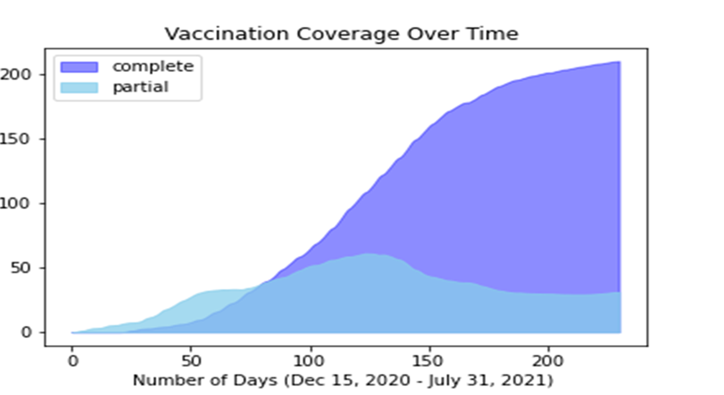

Slide 8
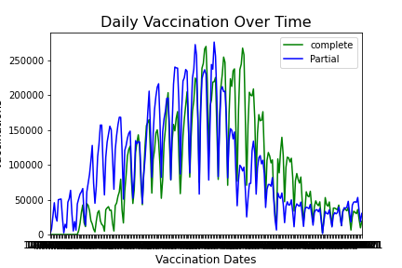
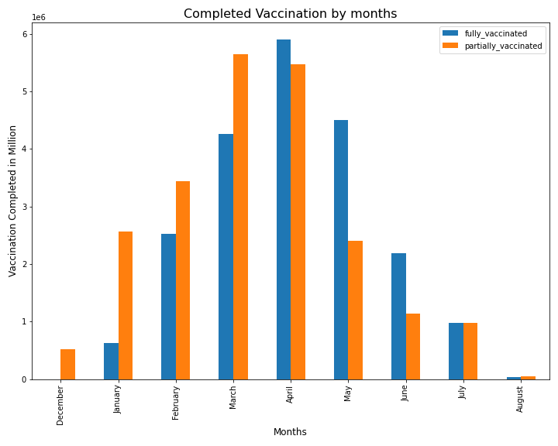
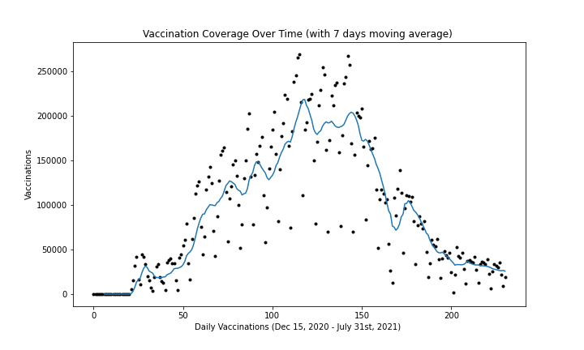
Project analysis slide 5
Analysis

Slide 9
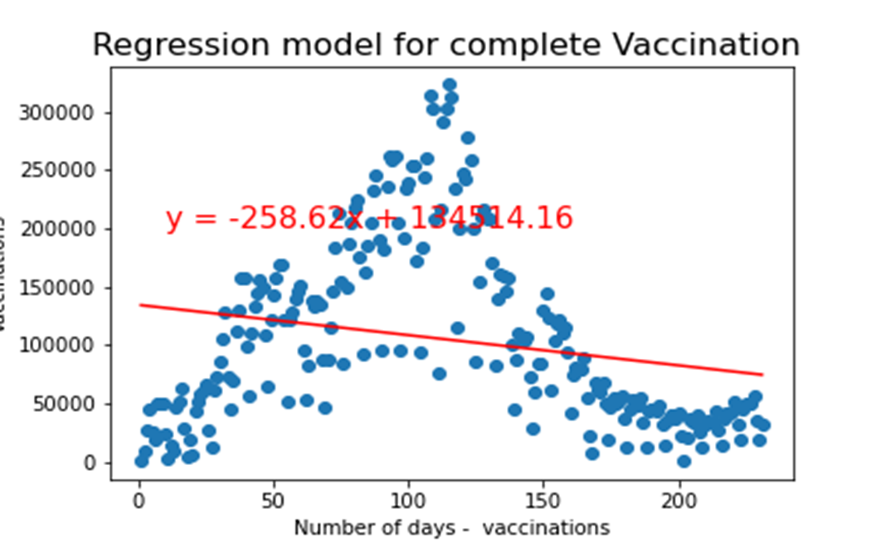
The statistics shows, it can be estimated that the vaccination in California will be completed in about 521 days from the beginning, while all other compounding factors remain unchanged.

Slide 10
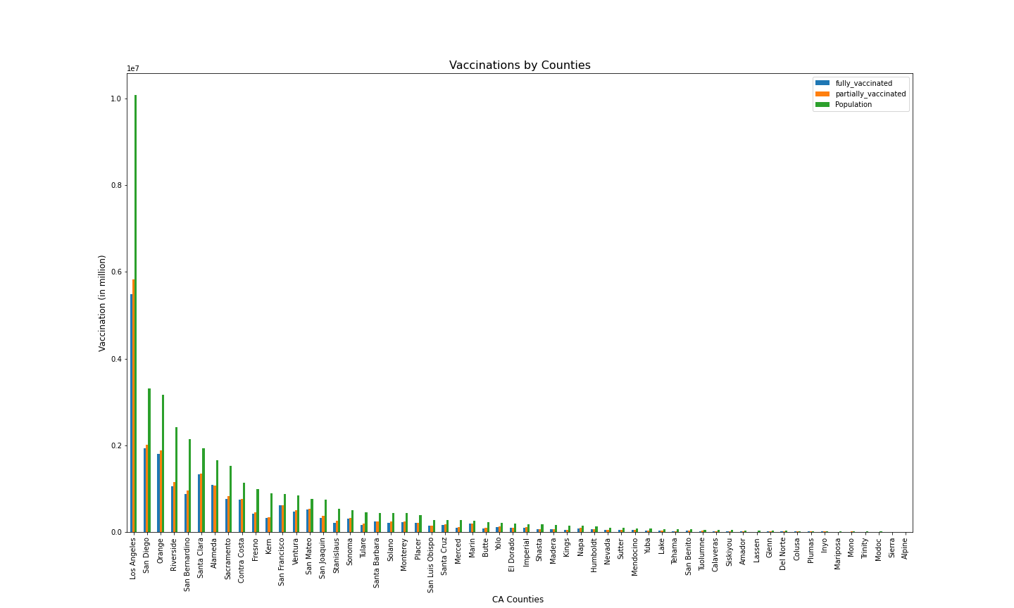
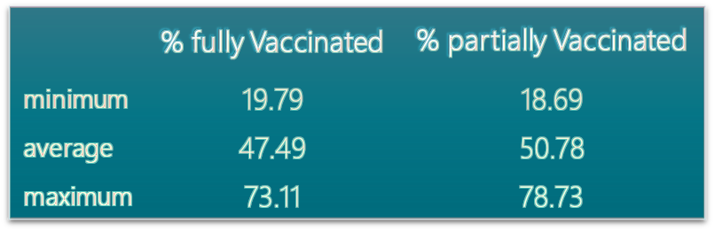
Analysis
Variation in the average percentage of vaccination is observed by population among counties
The vaccination percentages for counties varies from less than 20% to more than 70%.
- Highly vaccinated counties are Marin county and San Francisco county where the % vaccination is higher than 70%.
- Lassen county has the Lowest percentage of vaccination (less than 20% )

Slide 11
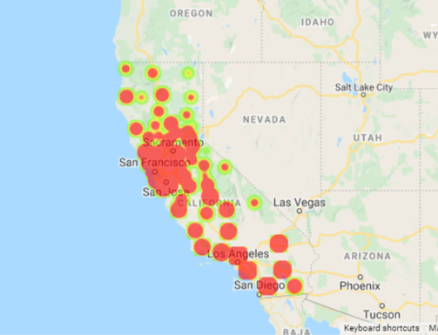
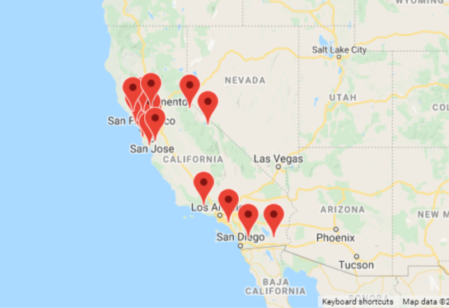
Locations and vaccination
Urban and highly populated counties are found to have higher vaccination compared to the rural and less populated counties.
Counties - Complete Vaccination
Counties- higher average vaccination than State average

Slide 12
How strong is the correlation between cases/deaths, and vaccination rates?
My intention when going through this data was to find the strength of the correlation between COVID cases and vaccination rates as well as COVID deaths and vaccination rates. My hypothesis was that there is a high level of correlation between these factors. As one would expect, the statistics show this hypothesis was correct. However, I wanted to try and provide an independent confirmation of this hypothesis, since many of the unvaccinated do not believe the information they get from what they consider “mainstream media”.

Slide 13
CDC
I downloaded all of the information on COVID cases from the CDC website, and then got to work cleaning it.

Slide 14
USAFacts.org
I found the data on COVID deaths in California counties from USAFacts.org. I discovered this site after seeing that they were referenced as a trusted data source in an NPR (National Public Radio) article I was reading.

Slide 15
Data Cleanup David
Describe the data exploration and cleanup process

Slide 16
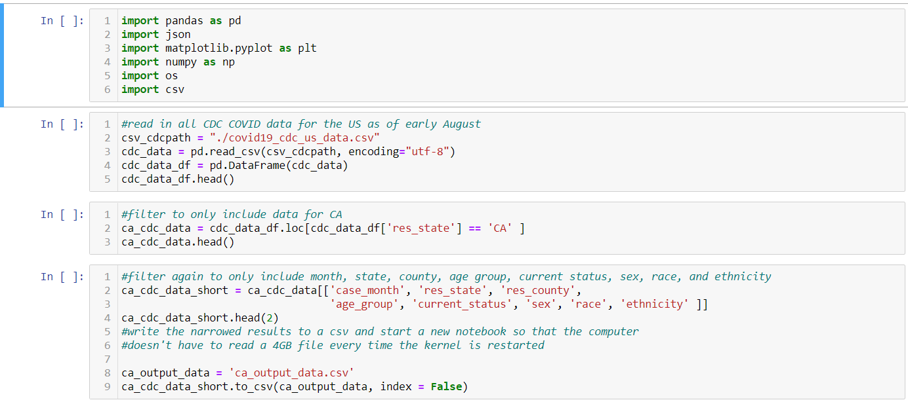
CDC Cleaning

Slide 17
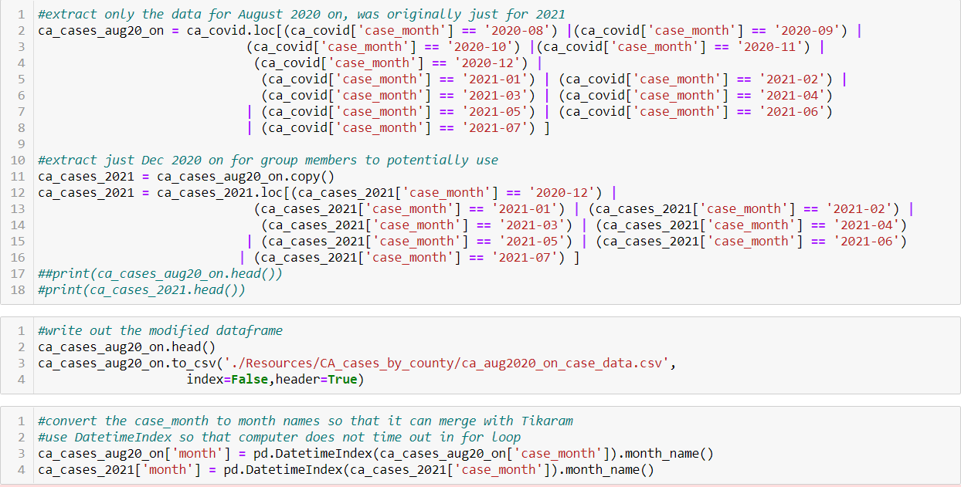
CA CDC Data Cleaning

Slide 18
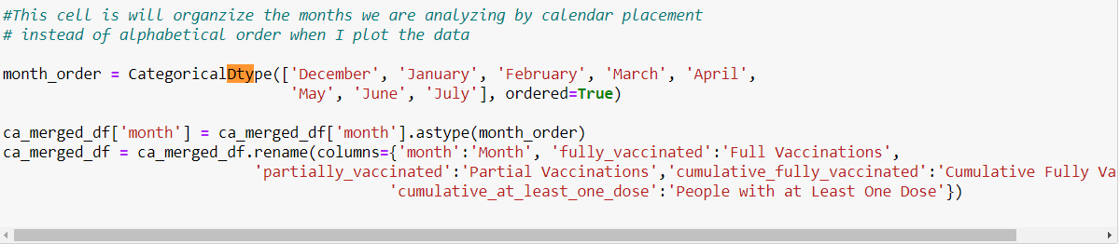
CategoricalDtype Sorting

Slide 19
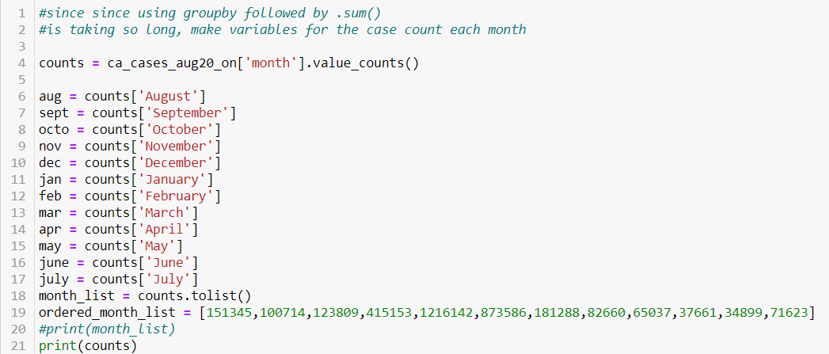
Manually Code Cases per Month

Slide 20
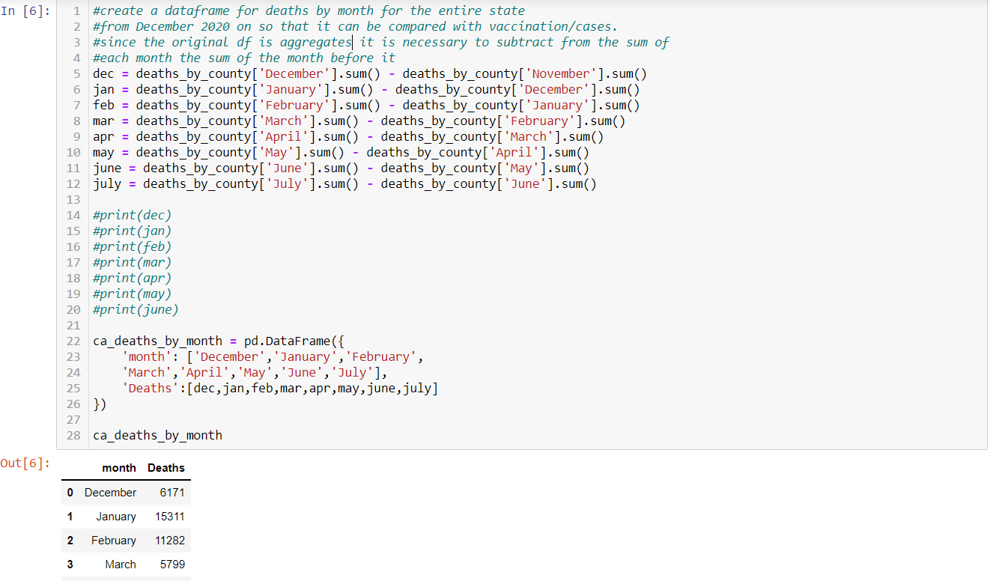
Finding Monthly Death Totals

Slide 21
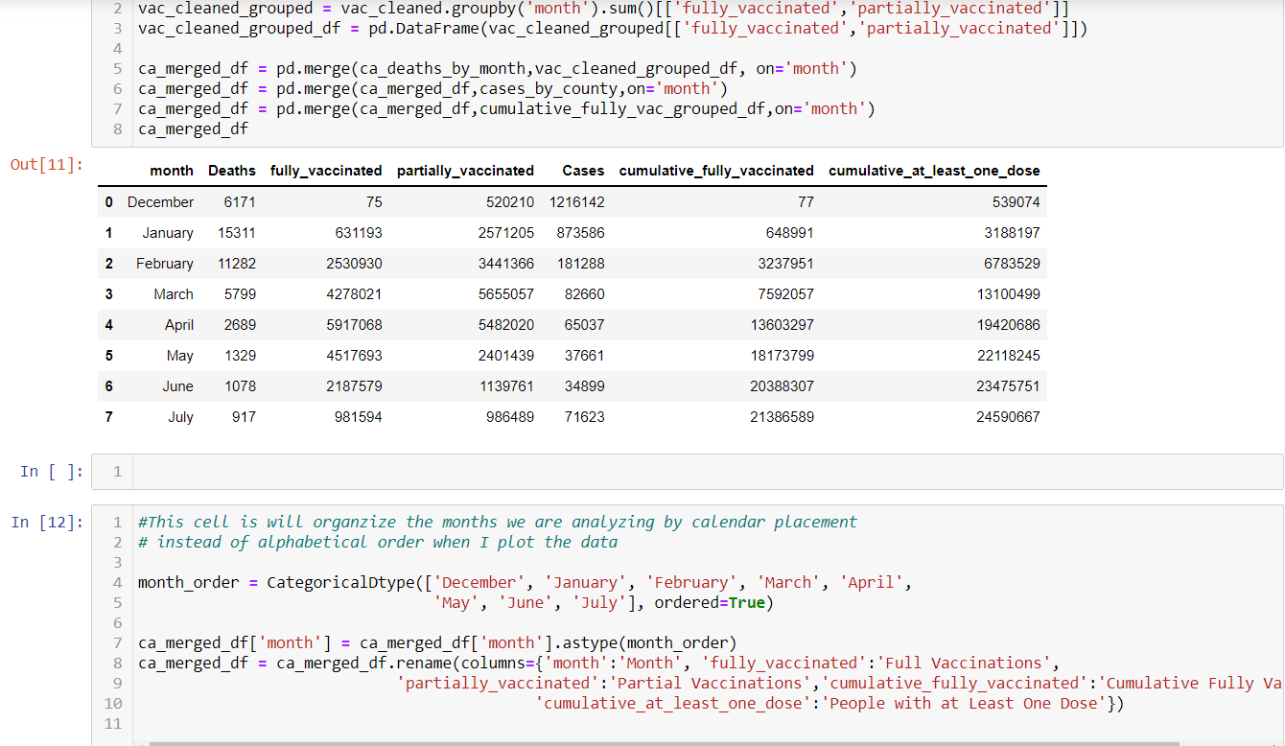
Merging the Cleaned Dataframes

Slide 22
Describe the Analysis Process
Screen shots of code and output
Describe the analysis process

Slide 23
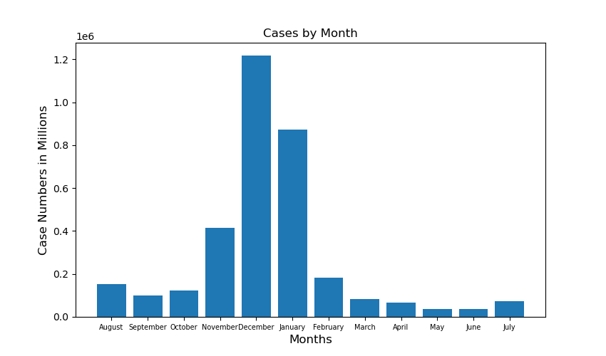
Cases By Month Bar Chart

Slide 24
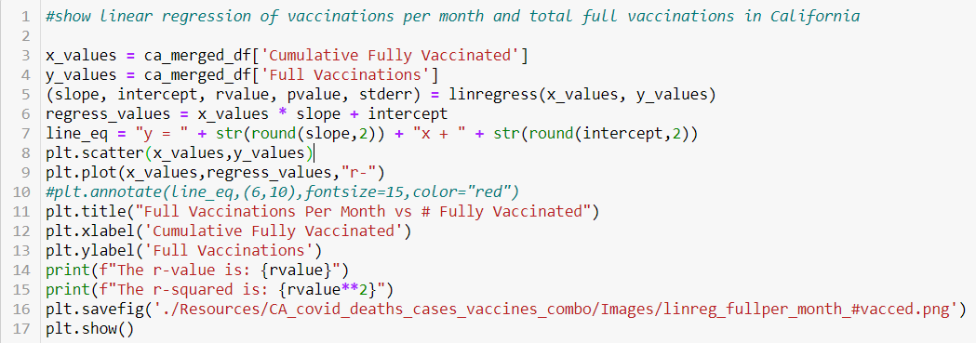
Fully Vaccinated per Month vs. Fully Vaccinated Total Code

Slide 25
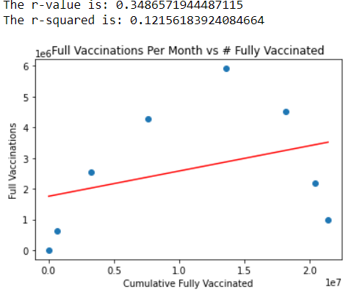
Fully Vaccinated Per Month vs. Fully Vaccinated Total

Slide 26
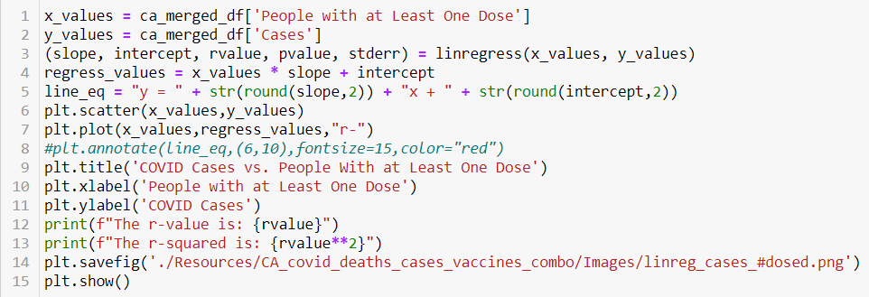
Cases vs. Total With One or More Shots Code

Slide 27
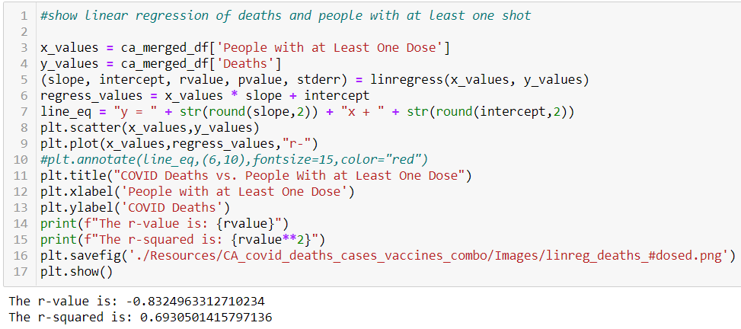
Deaths vs. Total With One or More Shots Code

Slide 28
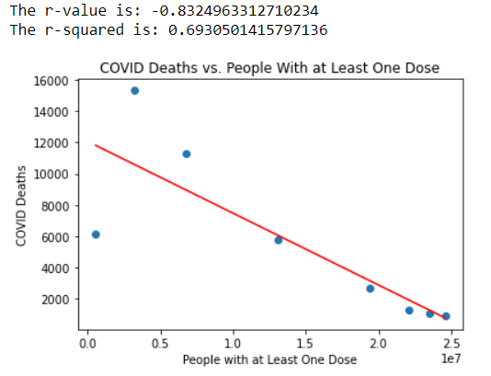
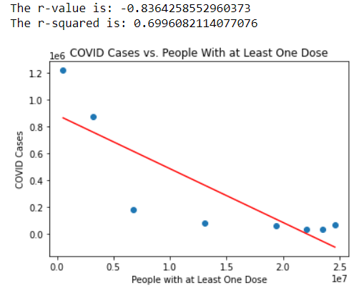
Cases and Deaths vs. Total With One or More Shots

Slide 29
Do demographics affect vaccination rates?

Slide 30
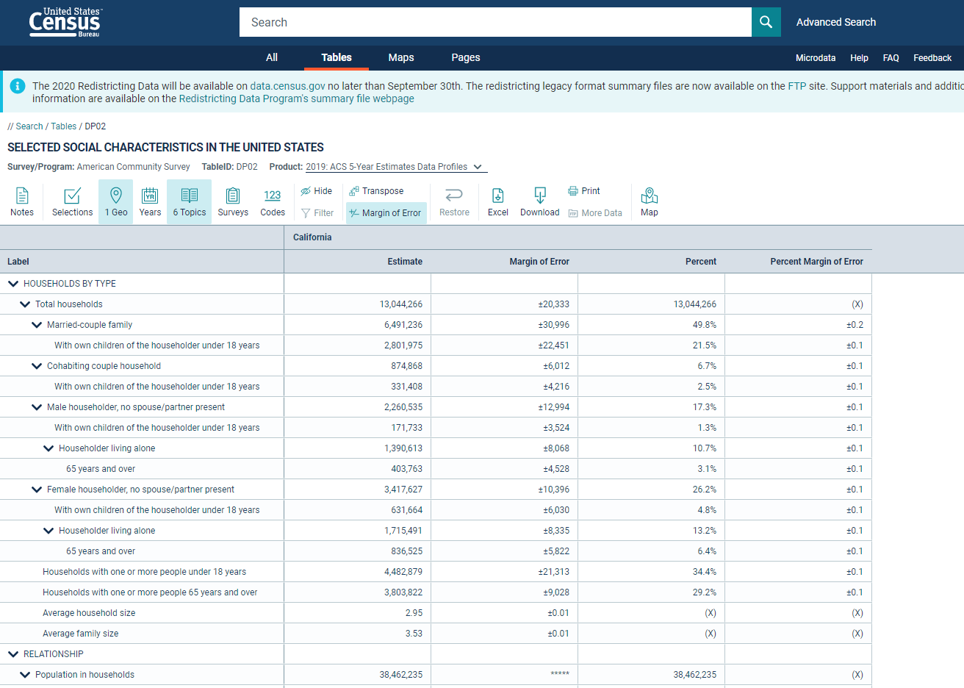

Slide 31
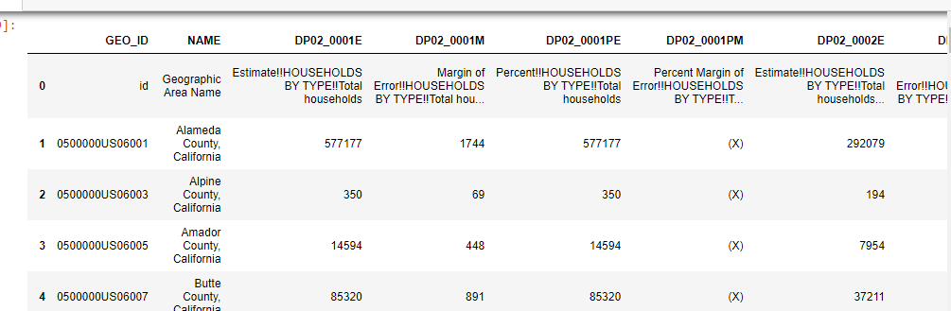
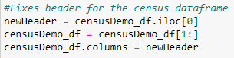
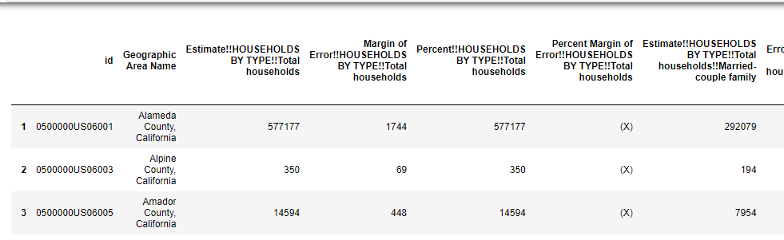
Imported .csv as DataFrame:

Slide 32
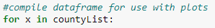
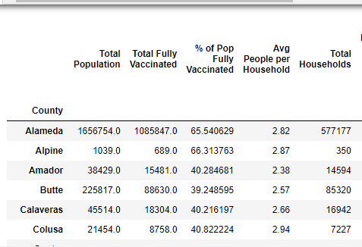
*
*

Slide 33
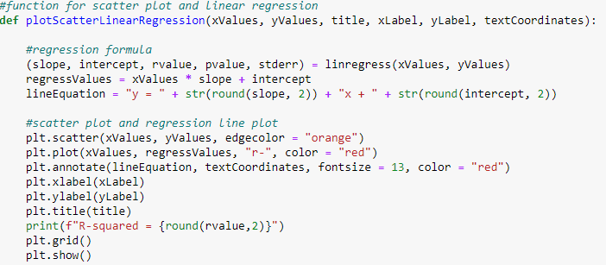

Slide 34
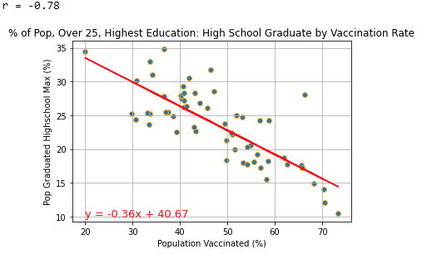
R² = -0.78

Slide 35
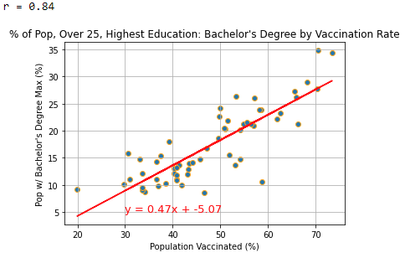
R² = 0.84

Slide 36
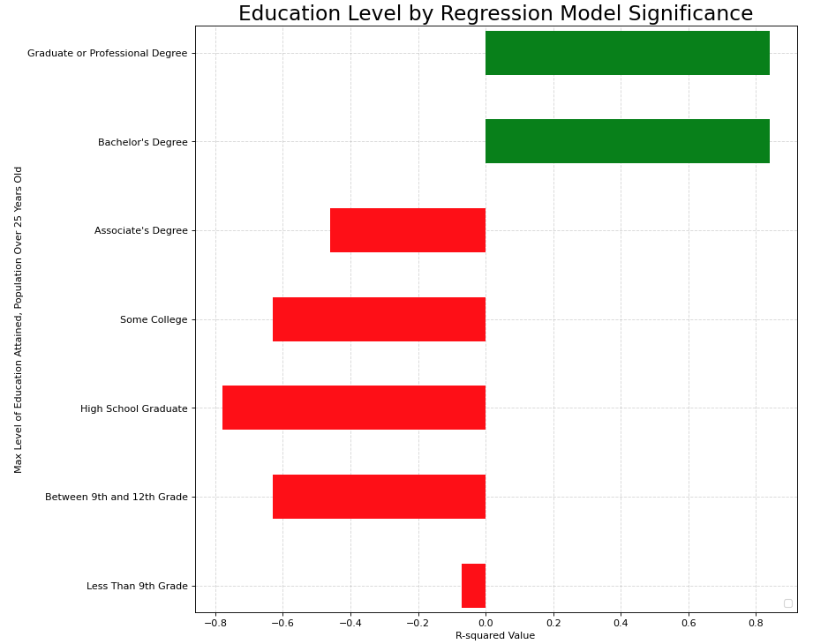
Increasing Relationship with Vaccinations
Decreasing Relationship with Vaccinations

Slide 37
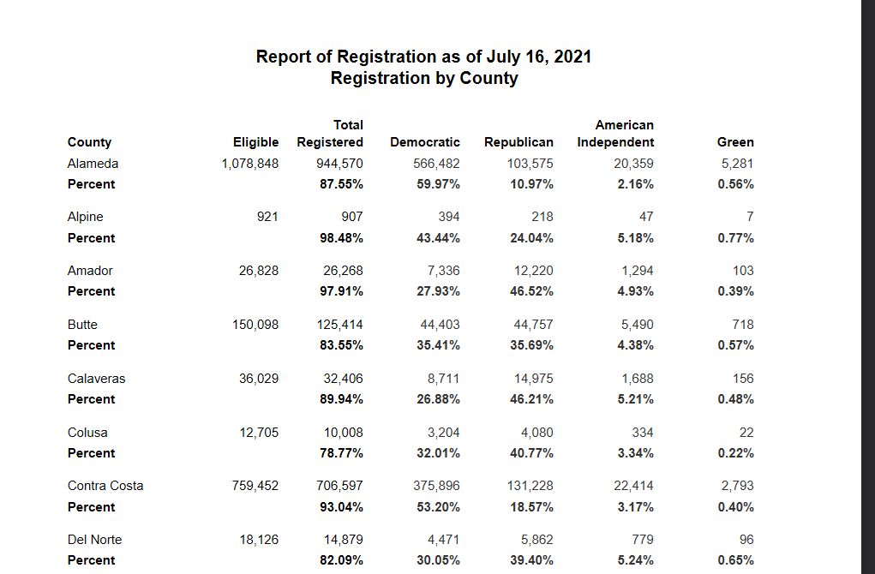
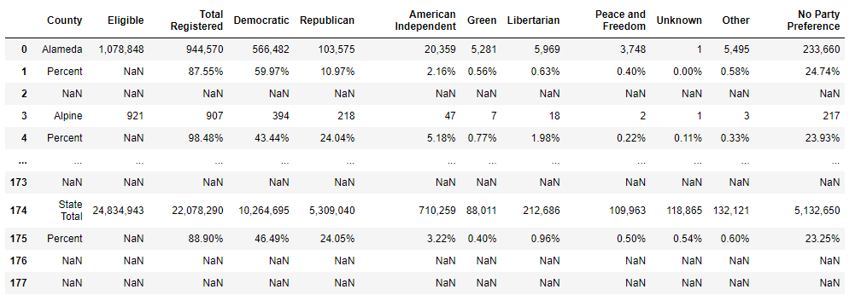
Save As .csv and import as DataFrame
.xls available from website

Slide 38
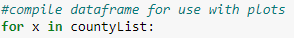
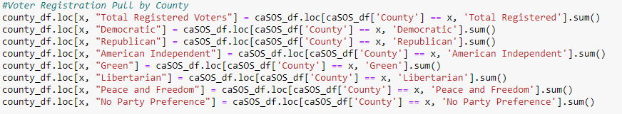
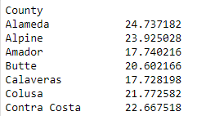

Slide 39
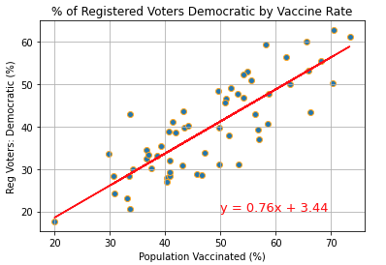
R² = 0.83

Slide 40
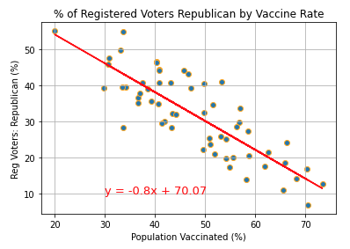
R² = -0.83

Slide 41
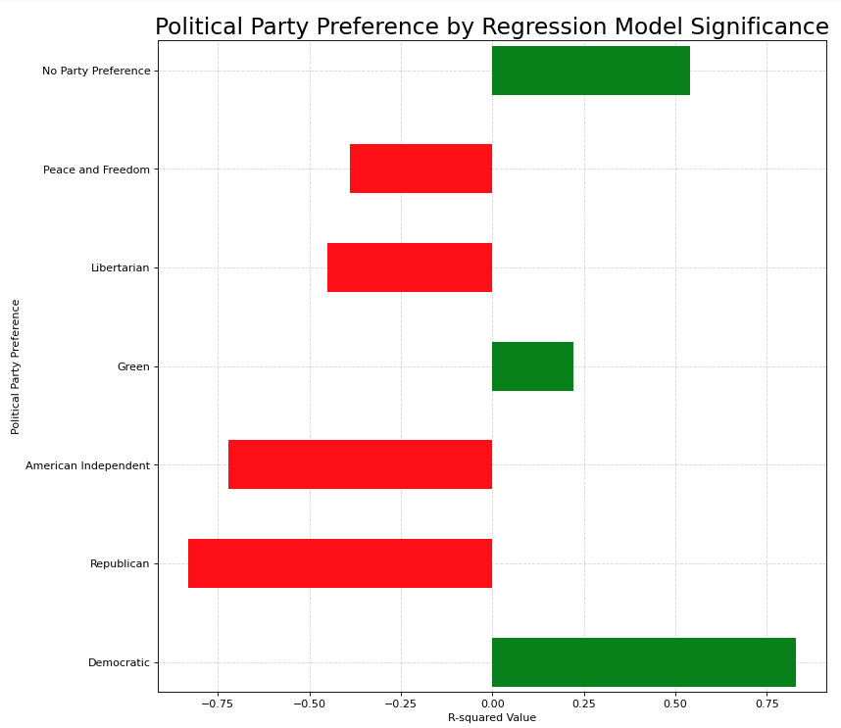
Increasing Relationship with Vaccinations
Decreasing Relationship with Vaccinations

Slide 42
Do demographics affect vaccination rates?
Strong R-squared values indicate yes.
Limitations:
Census data is from 2019.
Small sample size with only 58 California Counties.
Recommendations:
Get people to go to college?

Slide 43
Thank You

